Slide 1
PH203: Vacuum Science and Techniques Assignment
Calculation Of Pumping and Throughput Speed

Slide 2
OUR TEAM
Adarsh Kumar (2001CS02)
Astha Singhal (2001CS12)
Divyanshu Chandra (2001CS25)
Kalpana Bishnoi (2001CS32)
Mihir Mantri (2001CS46)
Siddhant Gupta (2001CS69)

Slide 3
Problem Statement
Write a computer program to calculate the throughput and pumping speed required for the vacuum chamber.
Implementation:
In this project, we have deployed a web application interface using CSS, HTML and JavaScript. Calculation of throughput and pumping speed can be done by using two different methods:
Using gas equation
Formula for pumping speed for a diaphragm pump

Slide 4
How to use Computer Programme
Web application: https://4d4r5h.github.io/PH203-Project/
Inputs:
For Gas Equation:
Mole of gas
Pressure in (Pa)
Temperature in (K)
Time (s)
For Suction Chamber:
Rotational Speed
Input Pressure (in Pa)
Output Pressure in (Pa)
Dead Space Volume (in m³)
Suction Chamber Volume (in m³)

Slide 5
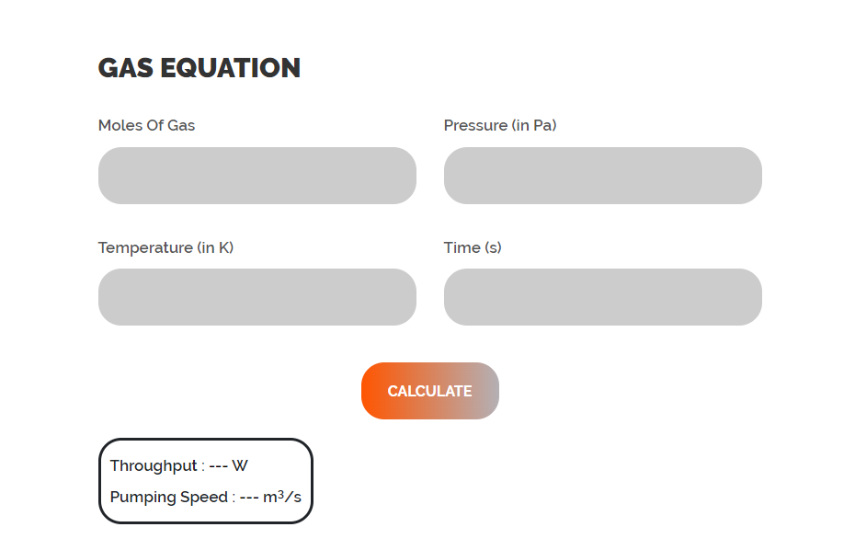
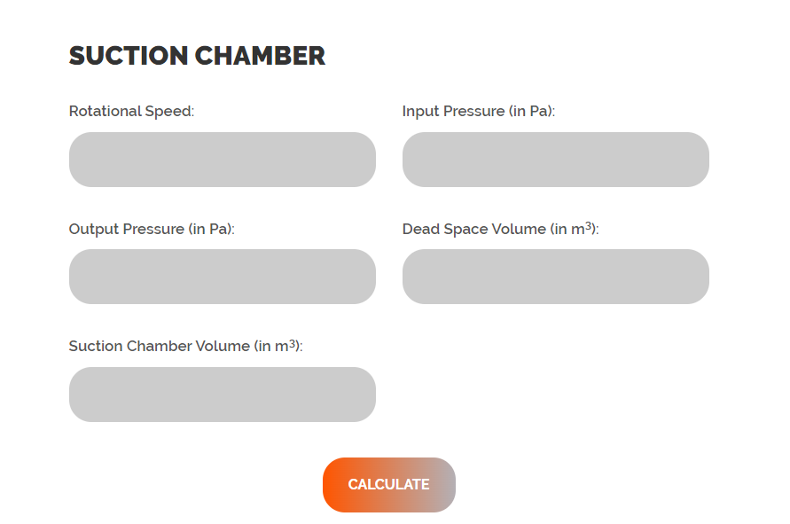
Snaps from the Website

Slide 6
Pumping Speed and Throughput
Pumping Speed: Pumping speed is formally defined as the ratio of the throughput of a given gas to the partial pressure of that gas at a specific point near the inlet port of the pump. With less formality, but more clarity, it is the volume of gas (at any pressure) that is removed from the system by the pump in unit time. Pumping speed is indicated in m3 · s-1. The units of m³ · h-1, l · s-1 and l · min-1 are also customary.
Throughput: Throughput is defined as the volume of gas moving through a plane, per unit time, multiplied by the pressure at the plane also known as “Gas Load”. Throughput is indicated in Pa m3 s-1
qpV = S⋅p = (dV/dt)⋅p

Slide 7
For Gas Equation
n = moles of gas
P = pressure (Pa)
T = temperature (K)
t = time (s)
Results:
Throughput = Q = (nRT)/t
Pumping Speed = S = Q/P

Slide 8
For Suction Chamber
r = rotational speed
Pi = input pressure (Pa)
Po = output pressure (Pa)
Vd = dead space volume (m3)
Vs = suction chamber volume (m3)
Results:
Throughput = Q = r*((Vs*Pi)-(Vd*Po))
Pumping Speed = S = Q/Pi

Slide 9
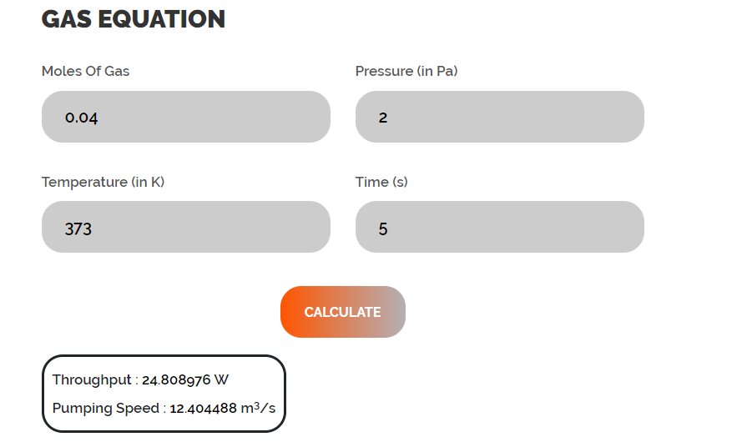

Slide 10
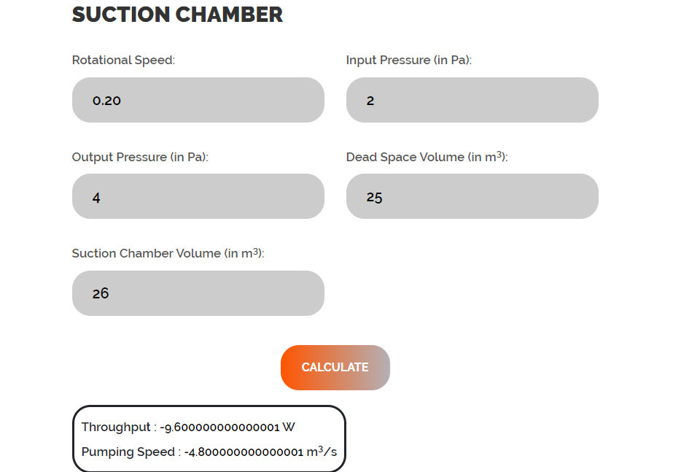

Slide 11
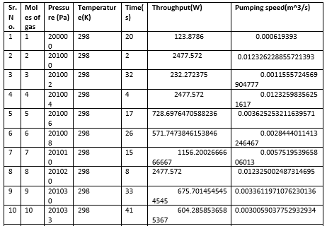
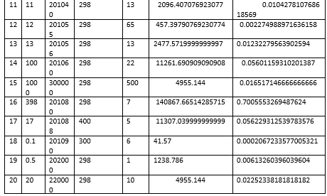
Data calculated using gas equation

Slide 12
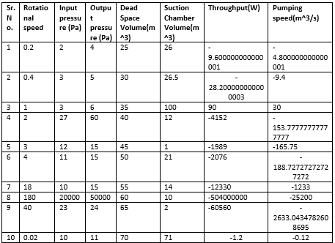
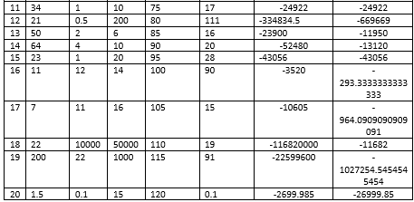
Data calculated using suction chamber

Slide 13
THANK YOU

